Slide 1



Sales Analysis Presentation

Slide 2

Bike Stores Performance Review
Sales Performance
Review of key sales metrics and factors driving the sales performance of bike stores.
Profit Analysis
Analysis of profit margins and key drivers of profitability for bike stores.
Growth Insights
Insights into growth trends and strategies contributing to the overall growth of the bike stores.
Notes:
Key sales, profit & growth insights Prepared by: Mohamed, Ahmed, Nourhan

Slide 3



Agenda
Agenda
ETL
Data Modeling
KPIS
Power Pivot
Dashboards

Slide 4
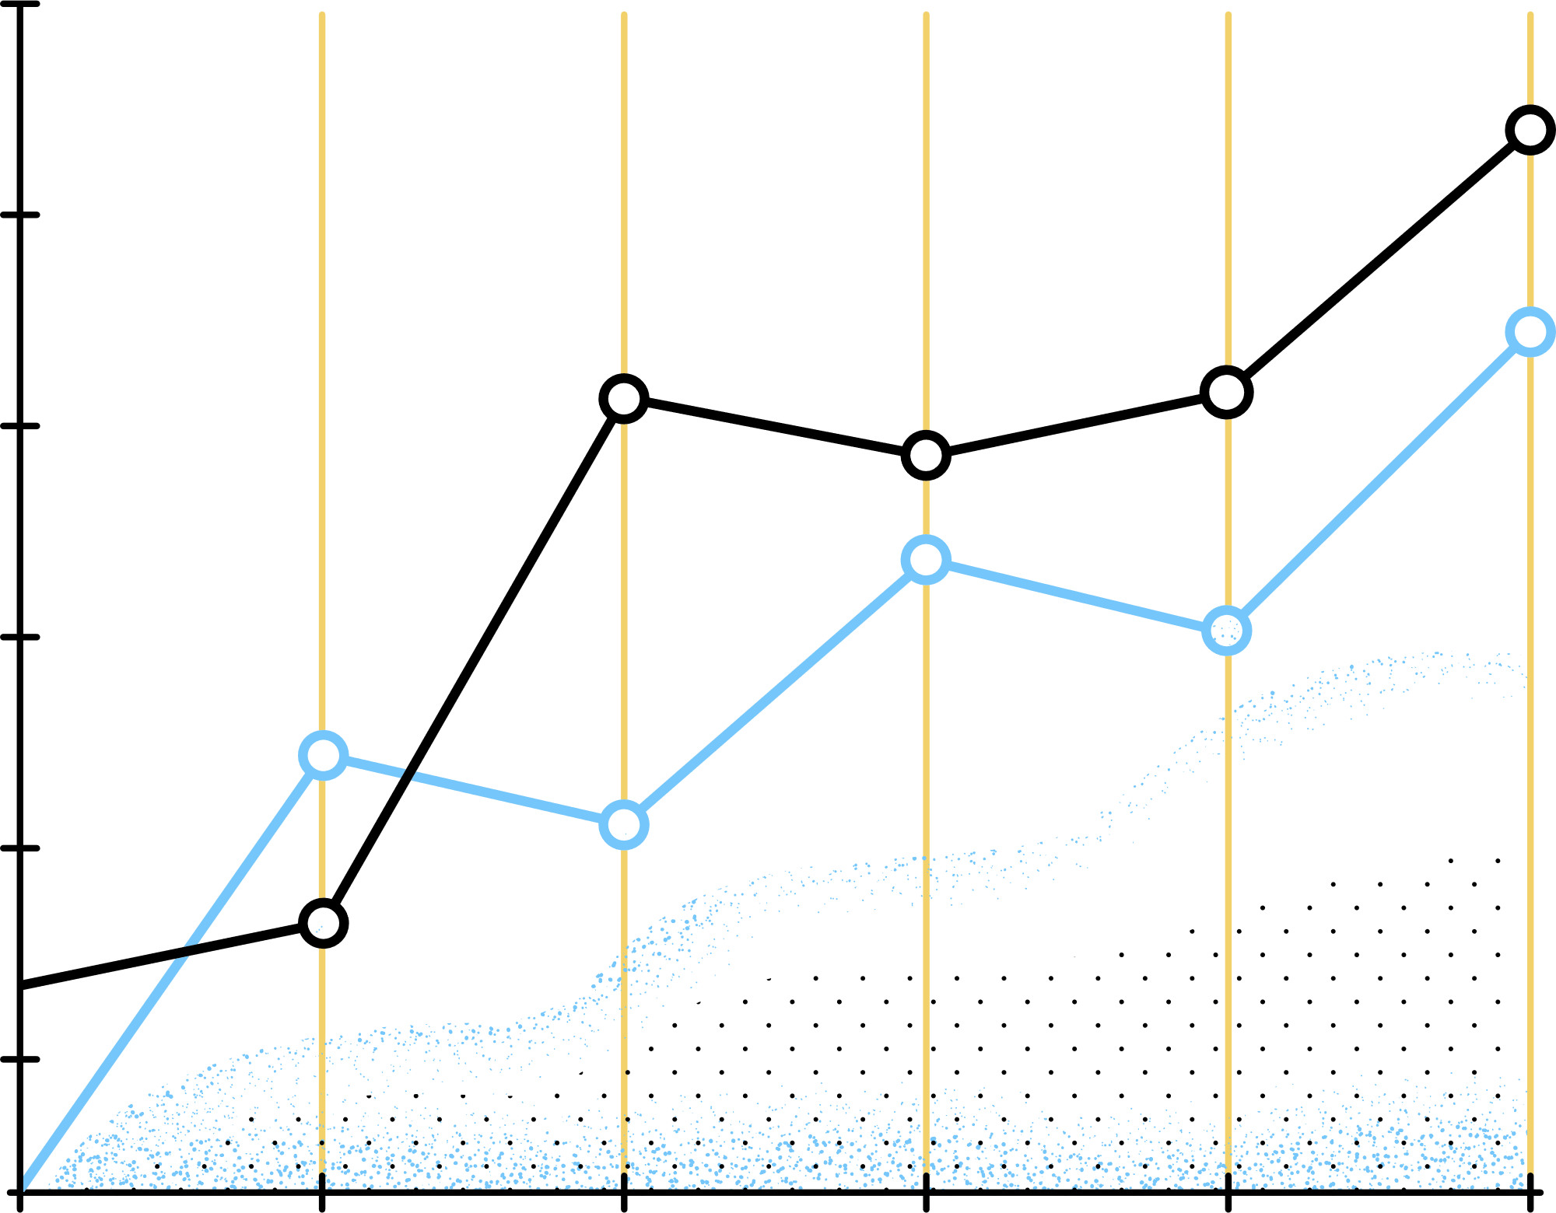
ETL
Extracted raw datasets from our SQL database.
Conducted an in-depth data exploration to grasp context and business meaning.
Mapped and documented relationships across tables to guide analysis.
Cleaned, standardized, and transformed the data for accuracy and consistency.
- Engineered calculated fields and measures to surface key performance indicators.

Slide 5

Data Transformation Flowchart
Visual representation of data processing steps.
SQL serves as the initial data source.
Power Pivot is utilized for data modeling and analytics.
Transformed data prepares it for insightful analysis.
Key steps include Business Rules and data-type conversion.
Notes:
This slide presents a flowchart that outlines the process of transforming data from SQL to Power Pivot. Each element of the flowchart represents a crucial step in ensuring the data is processed correctly. Key steps highlighted include managing null values and converting data types, which are essential for maintaining data integrity and usability.

Slide 6
Data Modeling
Created a data-model diagram to visualize table structures.
Identified and defined the central fact table.
Established and configured key-column relationships across tables.

Slide 7
Orders Data Model Overview
Central ‘Sales Order Item' table includes key metrics.
Dimension tables enhance contextual data.
Relationships established for data integrity.
Confirm hierarchies within dimensions.
Notes:
This slide provides an overview of the 'Orders' data model. The central table aggregates key metrics such as sales, cost, quantity, and profit, while dimension tables enrich the dataset with contextual information. It's vital to confirm the relationships and hierarchies within the dimensions and to establish clear naming conventions for better data management.

Slide 8
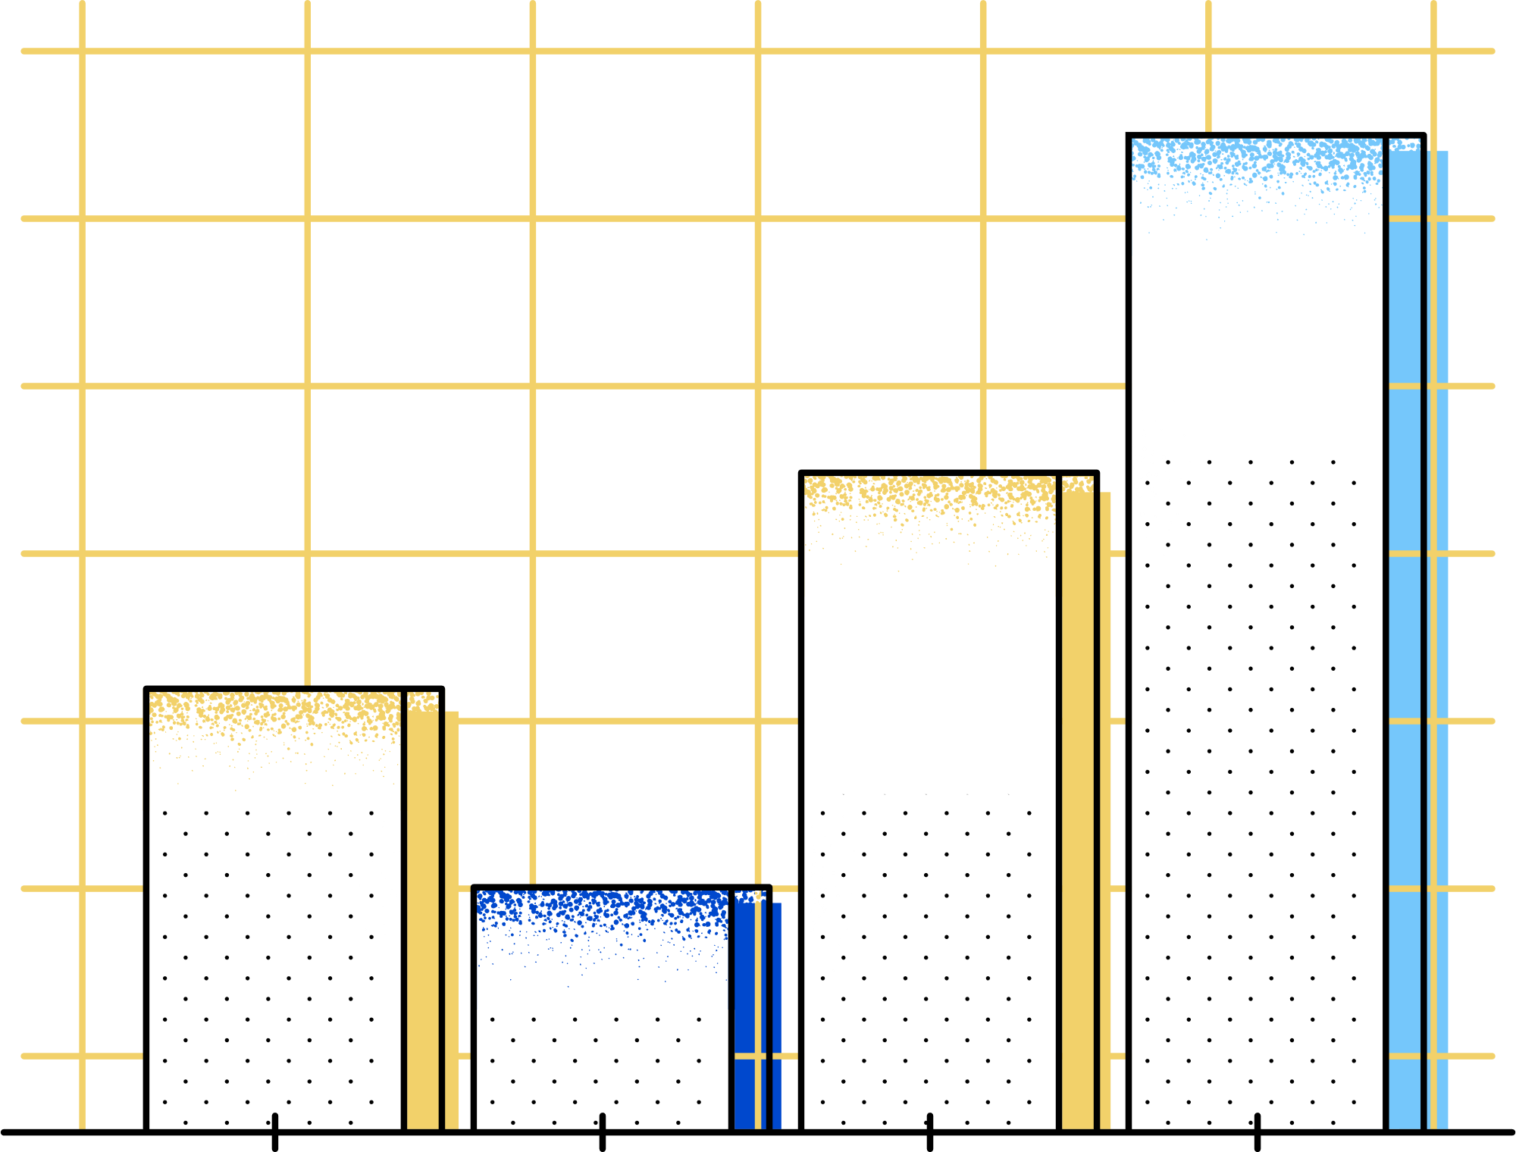
KPIS
Total cost
Total sales
Total profit
Total quantity sold
Average order value

Slide 9

Key Performance Indicators
Total Sales calculated as the sum of Sales Amount.
Total Cost is derived from the sum of Cost Amount.
Profit is determined by subtracting Total Cost from Total Sales.
Profit Margin is calculated as Profit divided by Total Sales.
Average Order Value (AOV) is Total Sales divided by Order Count.
Total Quantity is the sum of all Quantity sold.
Notes:
This slide outlines key performance indicators essential for assessing business performance. Each KPI provides insights into sales efficiency and profitability. The visual representation of these metrics through cards makes them easily digestible. Calculating these KPIs accurately helps in making informed strategic decisions that drive overall business growth.

Slide 10
Power Pivot Data Model
Import key tables like Orders and Products.
Establish relationships using drag-and-drop links.
Define measures using DAX for accurate calculations.
Calculate Total Sales, Profit Margin, and AOV.
Create hierarchies to organize data effectively.
Notes:
This slide focuses on the Power Pivot Data Model, highlighting the import of key tables such as Orders and Products. It emphasizes the importance of establishing relationships using foreign key to primary key links for accurate data analysis. Additionally, defining measures with DAX is essential for calculations like Total Sales and Profit Margin, while building hierarchies aids in organizing the data effectively.

Slide 11
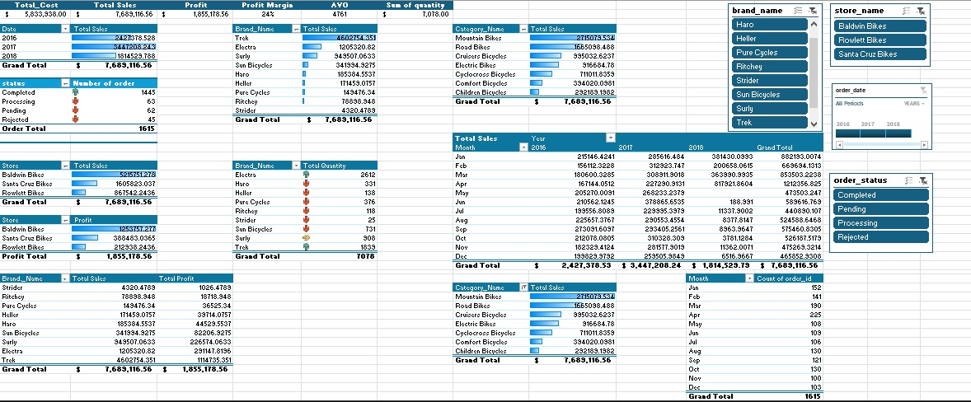
Power Pivot
Based on the KPIs, we identified the values we need to extract through Power Pivot.

Slide 12
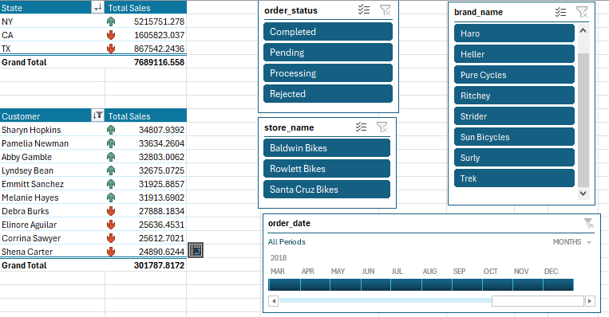
Power Pivot

Slide 13
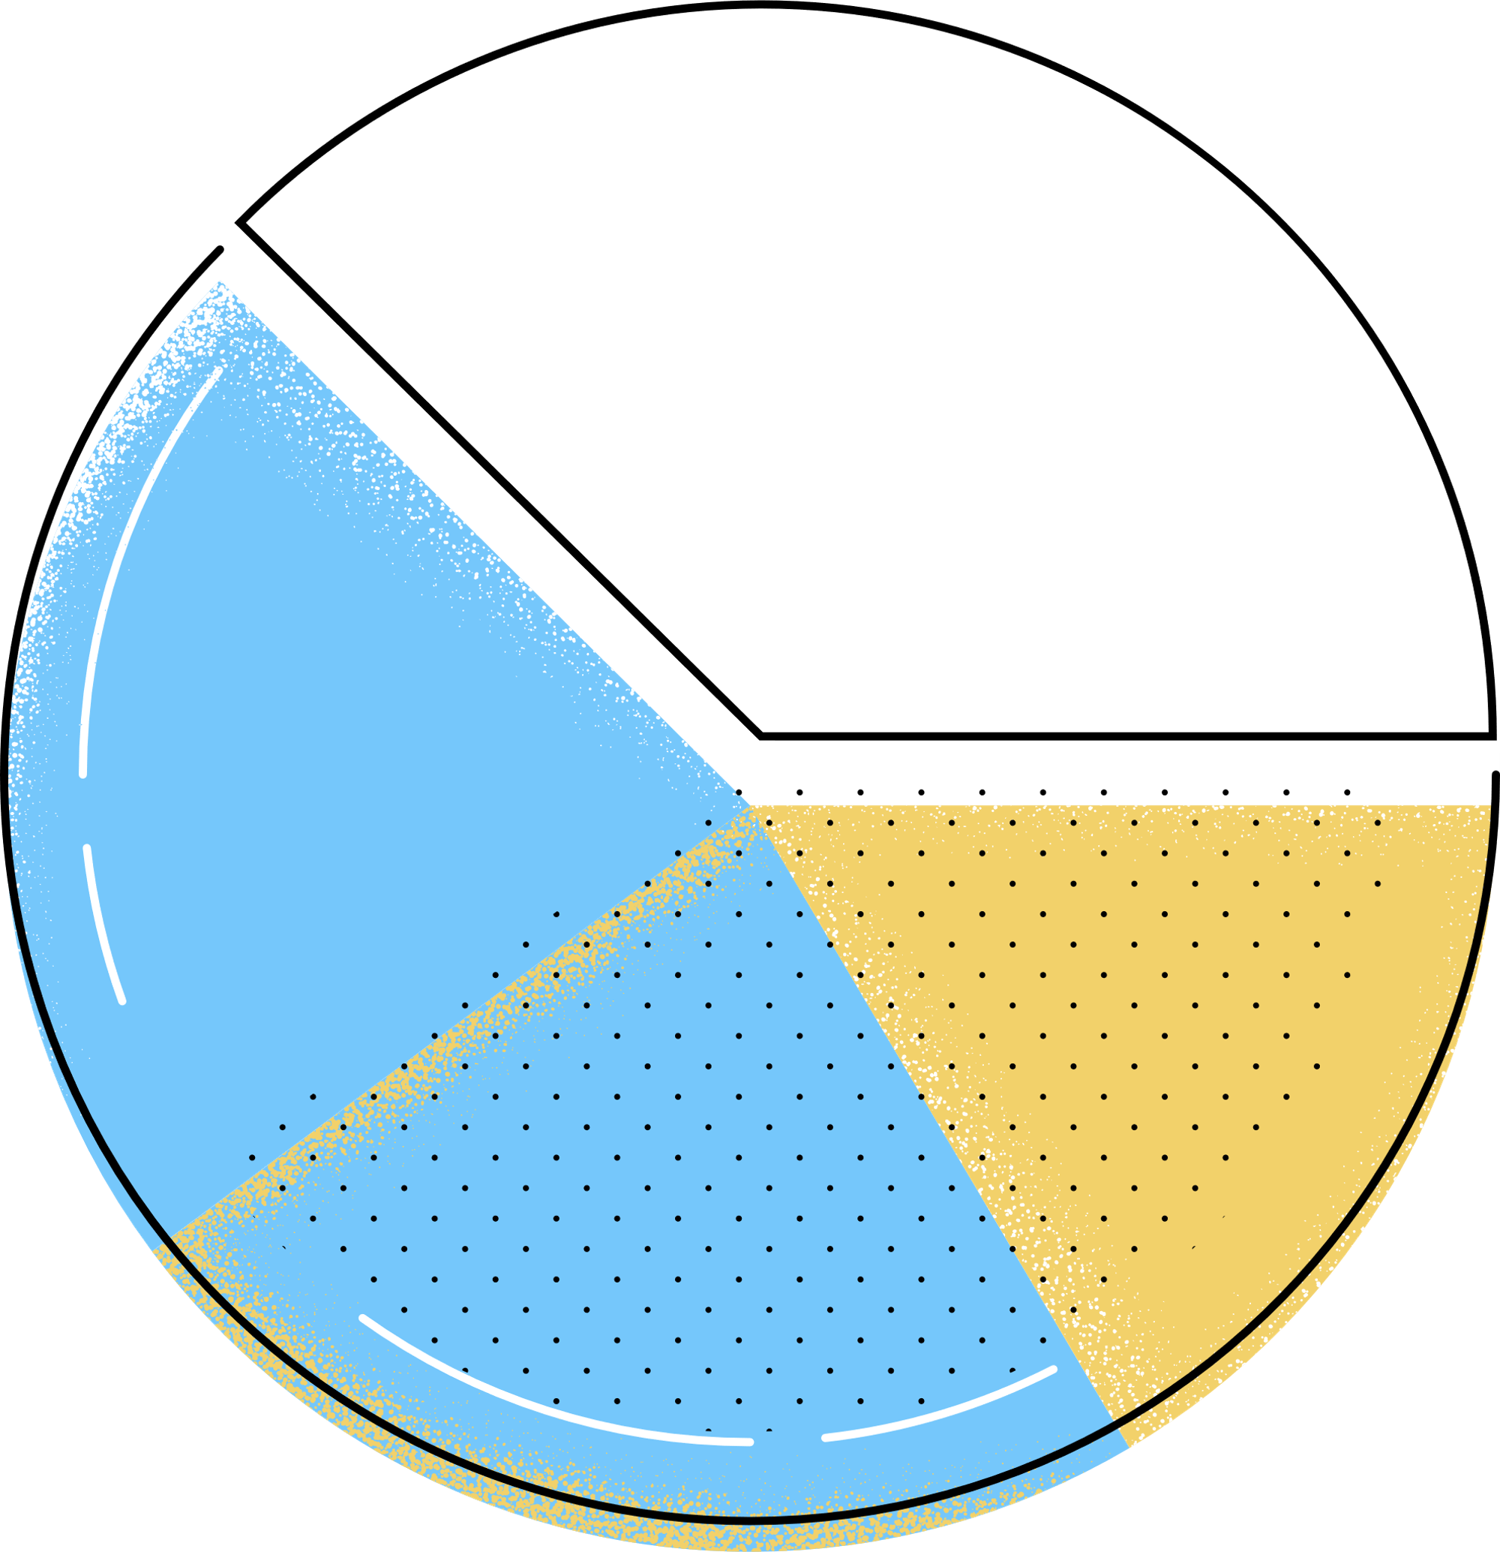
Dashboard
- Aligned each KPI with the optimal chart type based on its data structure and storytelling goal.
- Organized the dashboard into three key sections:
The Dashboard classify into:
Home page
Order Analysis Dashboard
Customer Analysis Dashboard

Slide 14

Dashboard Sections
Home Page provides access to the Orders Dashboards
And Customer Dashboards
Order Analysis includes charts for sales trends.
Customer Analysis features RFM and retention graphs.
Visuals include wireframes of the dashboard's layout.
Navigation menu displays user interaction options.
Notes:
This slide outlines the main sections of the dashboard. The Home Page will showcase key performance indicators, serving as a summary. Order and Customer Analysis will provide detailed insights through various charts. Additionally, the visual elements present a clear wireframe layout and navigation options, enhancing user experience.

Slide 15
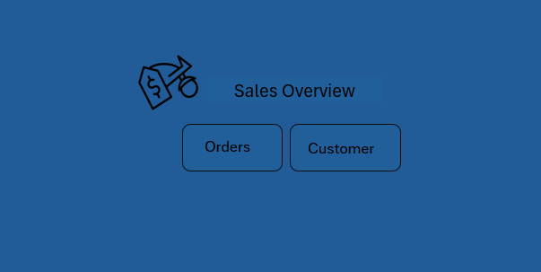

Slide 16
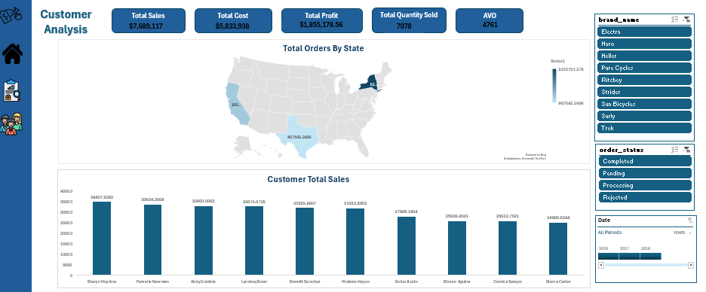

Slide 17
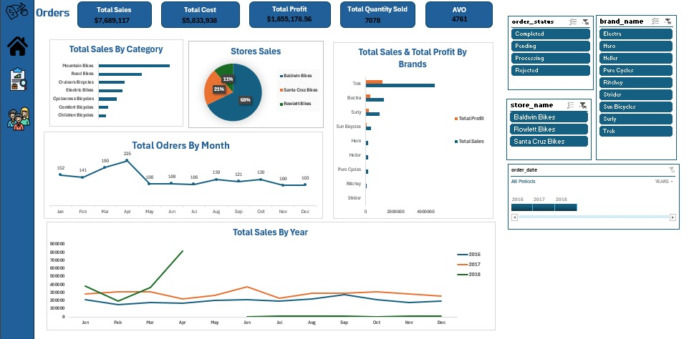

Slide 18

Key Findings & Insights
Sales peak during May to July, with significant growth in July 2017.
Mountain and Electric bike sales represent a large portion of total sales.
The top 1 store contribute nearly half of total revenue.
High-value customers are crucial, generating a substantial share of repeat orders.
Notes:
This slide presents key insights from our sales analysis. Notably, we observe a significant sales peak in the summer months, particularly in July 2017. The data indicates that Mountain and Electric bikes are major contributors to our sales figures. Additionally, a small number of top-performing stores drive a considerable portion of revenue, highlighting the importance of high-value customers in ensuring repeat business.

Slide 19

Recommendations & Next Steps
Short-term:
-Increase stock of Electric and Mountain bikes.
-Target underperforming stores with localized promotions.
Mid-term:
-Launch loyalty incentives for repeat customers.
-Optimize staffing during peak traffic months.
Long-term:
-Pilot dynamic pricing for top-selling SKUs.
-Evaluate potential store openings in TX and CA.
Notes:
This slide outlines actionable recommendations divided into short, mid, and long-term strategies. In the short-term, focusing on inventory and targeted promotions can address immediate sales needs. Mid-term strategies aim to enhance customer loyalty and optimize operational efficiency, while long-term initiatives focus on pricing strategies and expansion opportunities.

Slide 20

Projected Impact & ROI
Revenue uplift expected between 8% and 12% during peak season.
Margin improvements estimated at 3% to 5% through promotions.
Projected cost savings due to reduced stockouts and markdowns.
Payback period anticipated within 4 to 6 months post-implementation.
Notes:
This slide outlines the anticipated financial benefits of the initiative. The projected uplift in revenue signifies the effectiveness of optimized inventory strategies. Additionally, improvements in margins through targeted promotions can enhance profitability. Cost savings from reduced stockouts play a crucial role in overall efficiency, and the payback period highlights the quick return on investment.

Slide 21

Questions & Next Steps
Thank you—happy to take your questions.
Key contacts for follow-up: Are
-Ahmed Mohamed Alsaed ahmedmohamedelsaeed217@gmail.com
-Nourhan Hashem
nourhanhashem38@gmail.com
-Mohamed Hossam
mohamed.hossam.mh01@gmail.com
Feedback or requests? Let's discuss dashboard refinements.
Notes:
This slide invites the audience to engage with questions and provides key contact information for follow-up. Emphasize the importance of feedback in refining the dashboards, and encourage attendees to utilize the space provided for live note-taking or capturing action items during the discussion.

